Slide 1

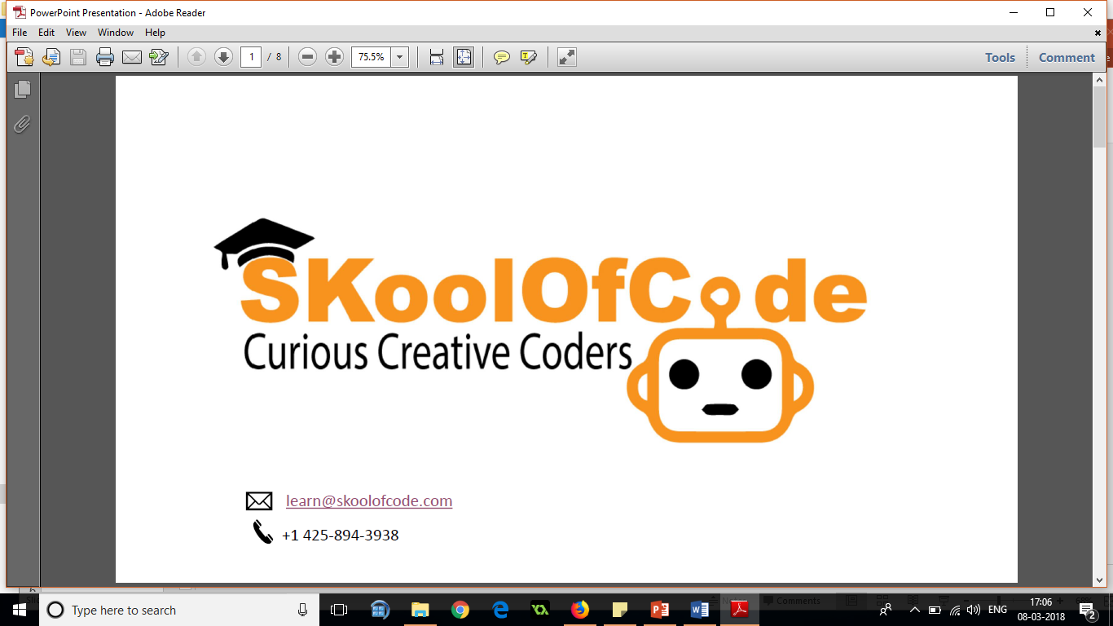
Robotics with Microbit – G34-5(level1)
The small little simple Computer
Notes:
IOT : The internet of things, or IoT, is a system of interrelated computing devices, mechanical and digital machines, objects, animals or people that are provided with unique identifiers (UIDs) and the ability to transfer data over a network without requiring human-to-human or human-to-computer interaction.

Slide 2

What is a Microbit
The Microbit is a pocket-sized computer that you can
code
customize
control to bring your digital ideas, games and apps to life.
super easy to use

Slide 3
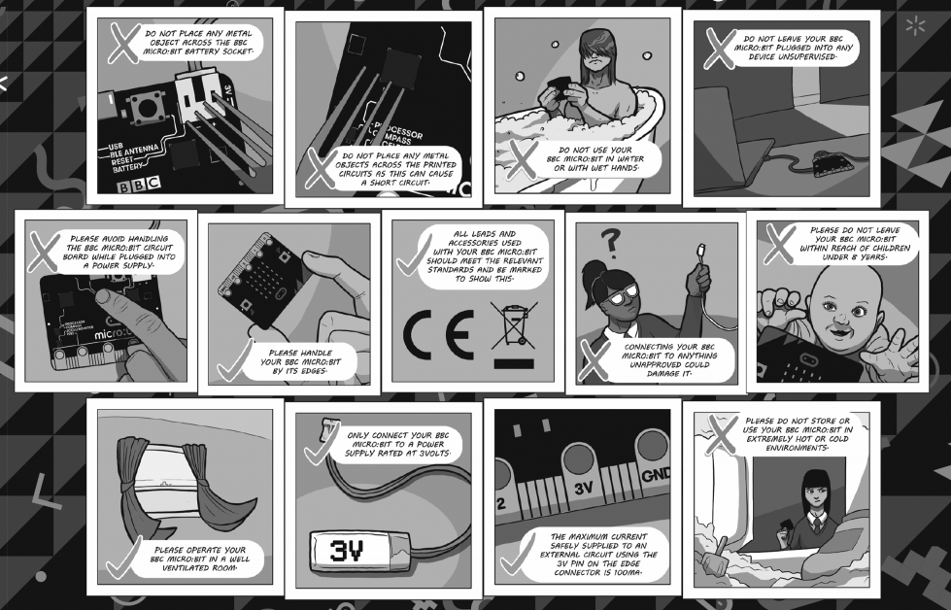
Safety instruction

Slide 4
Let’s Discuss Microbit
Features
25 red LEDs that light up, flash messages etc.
Has two programmable buttons.
Can use as a games controller
On board motion detector
Built in compass
Bluetooth connectivity

Slide 5
Let’s Discuss Microbit

Slide 6
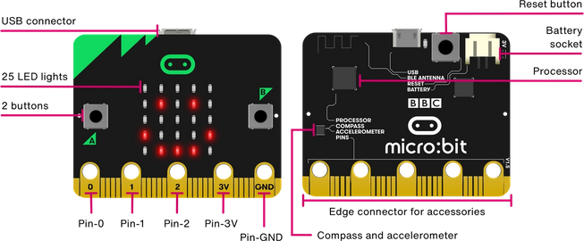
Micro:bit Hardware
https://microbit.org/get-started/user-guide/overview/

Slide 7
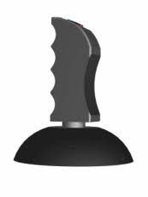
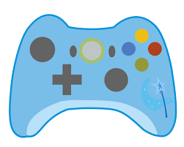

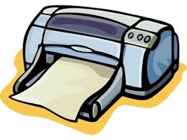
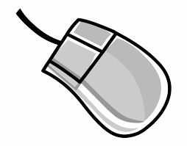
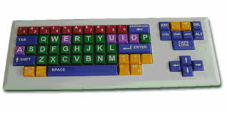
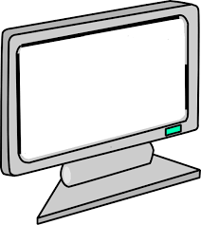
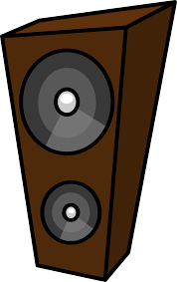

Input/Output Devices
Inputs and outputs are an important part of any computer system.
Input Devices | Output Devices
Joystick, Video Game Remote, Mouse, Keyboard | Headphones, Printer, Monitor, Speaker
As a very small computer, the BBC microbit has plenty of inputs and outputs.

Slide 8
The micro:bit
The micro:bit is an example of a microcontroller
It contains a number of input and output devices
The purpose of an input device is to allow data to be transferred into the computer system
The purpose of an output device is to transfer the data out of the system
Activity: using your micro:bit have a look at the different parts of the device. Can you identify any input or output devices?
Notes:
The purpose of the activity is to give learners their first opportunity to have a look at the micro:bit. Discuss what input and output devices are, using this slide, and then allow learners to independently look over the different components on the micro:bit. After 5 minutes ask learners what they have identified. The main output that many will identify will be the LED matrix i.e. the lights which make up the screen on the front of the device. The purpose of this is to display / output the data to the user. Some may identify that the USB socket acts as an output as it can be used to transfer data from the micro:bit to a computer. On the reverse of the micro:bit the Bluetooth antenna is labelled. This also allows data to be transferred from the miro:bit wirelessly. The main input devices which learners will identify will be Buttons A and B. The Bluetooth antenna and USB socket can also act as input devices. Highlight to learners the lines or wires that appear on the reverse of the micro:bit. These wires transmit the data between the different component parts. If there is time you could also highlight the compass and accelerometer. The compass will be used in a future lesson. The accelerometer allows gestures to be detected such as whether someone is shaking the micro:bit. This also acts as an input device.

Slide 9
Micro:bit Features (Front)
Buttons
Buttons are a very common input device.
The micro:bit has two buttons on the front that can be used separately or together to make things happen.
The micro:bit can detect which button is pressed and react to the button press or send information to another device depending on how you have programmed your microbit.
LED display & light sensor
An LED, or light-emitting diode is an output device that gives off light.
25 LEDs arranged in a 5x5 grid make up the display for showing pictures, words and numbers.
They can also act as sensors, measuring how much light is falling on your micro:bit

Slide 10
Let’s start the activities
Link to start coding with MakeCode –
https://makecode.microbit.org/

Slide 11
session1: Name Badge And Phases Of The Moon Topic: User interface design of MakeCode to code Microbit and Loops Activity: Display your name and Phases of the Moon on microbit LED’s Practice: Display a sad face followed by a text "Sad" and a happy face followed by the text "happy".
Notes:
This initial introduction reminds learners of the concept of input and output devices. You could use questioning prior to showing the slide to see if any learners are able to recall the material covered in the last lesson.

Slide 12
Name Badge Task
You are going to create your own name badge using the micro:bit
Once you have created your name badge attempt to complete the Stretch Tasks.
Notes:
Learners should then start to program their own name badge. This is the first time that learners will have used the micro:bit in the lesson and they are certain to enjoy the task. The most challenging part of the task will be transferring the hex file from the PC onto the micro:bit. This should initially be demonstrated by the Teacher. It is also worth stressing that all of the blocks are colour coded, which should help learners to find where they are located.
How to Ensure that MakeCode is available
Ensure the following website are unfiltered (a constantly updated list is available at https://support.microbit.org/support/solutions/articles/19000030385-firewall-whitelist-requirements-for-micro-bit-editors)
You need access to USB devices if these are blocked by default all Micro:bits use the same ID – use your security policy to exempt the micro:bit ID
PXT / MakeCode/Javascript Blocks Editor:
pxt.microbit.org
makecode.microbit.org
makecode.com www.pxt.io trg-microbit.userpxt.io pxt.azureedge.net
github.com Blocks:
www.microbit.co.uk
Touch Develop:
www.microbit.co.uk
Code Kingdoms:
www.microbit.co.uk
microbit.codekingdoms.com
Python Web Editor (microbit.co.uk)
www.microbit.co.uk
Python Web Editor (microbit.org)
python.microbit.org

Slide 13
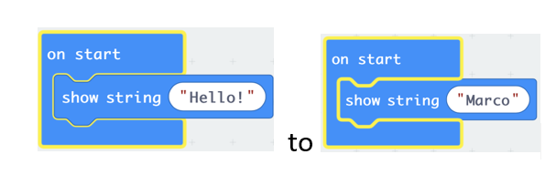
Name Badge Task
Log into your computer and go to https://makecode.microbit.org/
Click the Basic tools category and drag across the on start and the show string blocks as below.
Change the text from ‘Hello!’ to your own name.
From:

Slide 14
Name Badge Task
Congratulations! You have created your first program for the micro:bit. You can see what the output of your program will be by using the simulator.
Once you are happy with the program it is then necessary to transfer it to your micro:bit.
Once the file has transferred the micro:bit window will close and your program will run on the micro:bit.

Slide 15
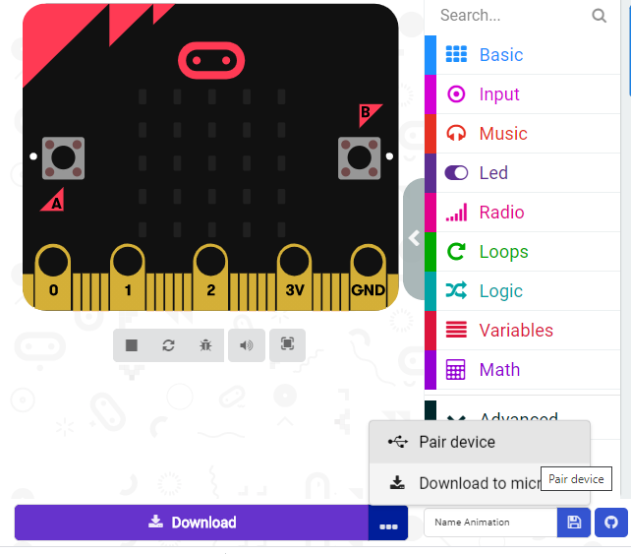
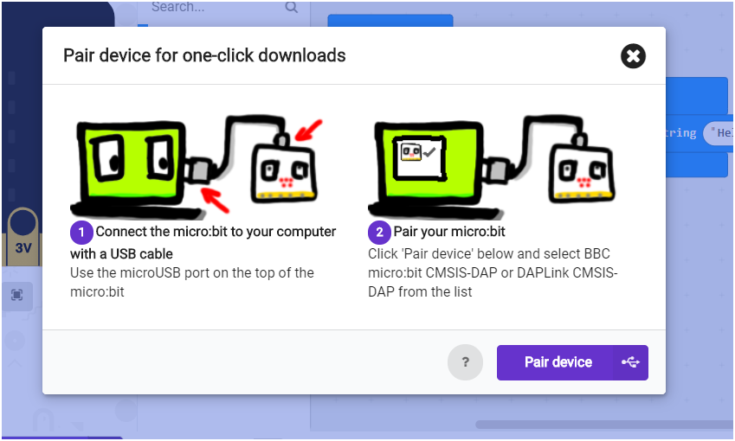
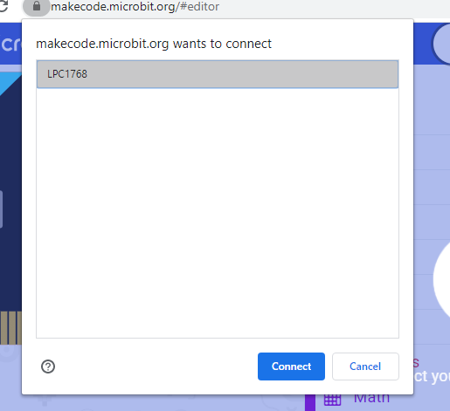
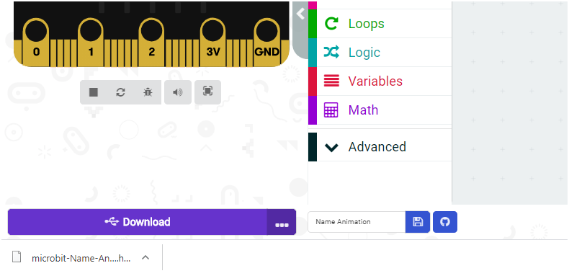
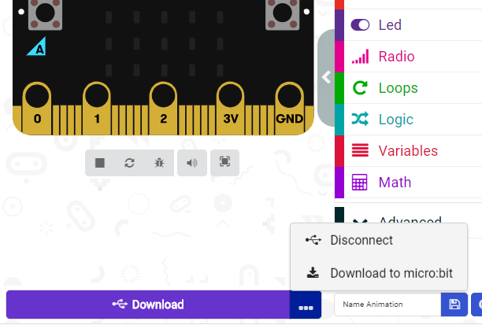
Connect Microbit
Get output of your program on Microbit by following these steps :
Click on 3 dots and then on ‘Pair device’ option
Click here
Select the device in dialogue box and click on ‘Connect’
One hex file will get downloaded and now output of program will start coming on connected microbit
Click on 3 dots again and now ‘Disconnect’ option will come which shows Microbit device got connected, then click on ‘Download to micro:bit’ option

Slide 16
Name Badge Task
Stretch Tasks
Why did the text only appear once? Make the text appear forever
Make your own icon using the show leds block
Modify the program so that each letter of your name is displayed repeatedly.

Slide 17
Phases of Moon
You are going to create phases of moon using the micro:bit
Identify the phases of Moon. Think of the sequence in which you want to display the phases.
Use show LEDs blocks to represent different phases of moon.
It’s a good practice to put comments in your code.
Notes:
Learners should then start to program their own name badge. This is the first time that learners will have used the micro:bit in the lesson and they are certain to enjoy the task. The most challenging part of the task will be transferring the hex file from the PC onto the micro:bit. This should initially be demonstrated by the Teacher. It is also worth stressing that all of the blocks are colour coded, which should help learners to find where they are located.
How to Ensure that MakeCode is available
Ensure the following website are unfiltered (a constantly updated list is available at https://support.microbit.org/support/solutions/articles/19000030385-firewall-whitelist-requirements-for-micro-bit-editors)
You need access to USB devices if these are blocked by default all Micro:bits use the same ID – use your security policy to exempt the micro:bit ID
PXT / MakeCode/Javascript Blocks Editor:
pxt.microbit.org
makecode.microbit.org
makecode.com www.pxt.io trg-microbit.userpxt.io pxt.azureedge.net
github.com Blocks:
www.microbit.co.uk
Touch Develop:
www.microbit.co.uk
Code Kingdoms:
www.microbit.co.uk
microbit.codekingdoms.com
Python Web Editor (microbit.co.uk)
www.microbit.co.uk
Python Web Editor (microbit.org)
python.microbit.org

Slide 18
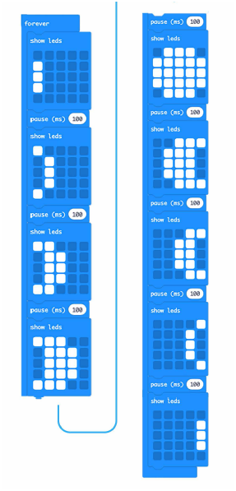
Phases of Moon
Code the Microbit to display the phases of moon on LED grid

Slide 19
Concepts Learnt
You have just learned to:
Create basic programs using MakeCode
Name and save your programs
Upload programs to your micro:bit
Extend your program

Slide 20
Session 2: Mathematical Bot
Topic: Variables and mathematical operators
Activity: Multiplication Revision Machine
Practice: Digital Dice - Code the Microbit to display the score of dice by pressing button A. On pressing button A, a random number between 1 to 6 should appear on the Microbit LED grid.

Slide 21
Multiplication Revision Machine
In this project we will make a program that gives simple maths problems and also the answers when needed to help young students practice their times tables.
Pressing a button gives a random multiplication problem using numbers between 1 and 10 .Pressing another button gives the answer.
Notes:
Learners should then start to program their own name badge. This is the first time that learners will have used the micro:bit in the lesson and they are certain to enjoy the task. The most challenging part of the task will be transferring the hex file from the PC onto the micro:bit. This should initially be demonstrated by the Teacher. It is also worth stressing that all of the blocks are colour coded, which should help learners to find where they are located.
How to Ensure that MakeCode is available
Ensure the following website are unfiltered (a constantly updated list is available at https://support.microbit.org/support/solutions/articles/19000030385-firewall-whitelist-requirements-for-micro-bit-editors)
You need access to USB devices if these are blocked by default all Micro:bits use the same ID – use your security policy to exempt the micro:bit ID
PXT / MakeCode/Javascript Blocks Editor:
pxt.microbit.org
makecode.microbit.org
makecode.com www.pxt.io trg-microbit.userpxt.io pxt.azureedge.net
github.com Blocks:
www.microbit.co.uk
Touch Develop:
www.microbit.co.uk
Code Kingdoms:
www.microbit.co.uk
microbit.codekingdoms.com
Python Web Editor (microbit.co.uk)
www.microbit.co.uk
Python Web Editor (microbit.org)
python.microbit.org

Slide 22
Multiplication Revision Machine
program button A. The numbers should be generated randomly so we will need to use a variable.
set the two variables to random numbers from 1 to 10 when button A is pressed. We now need to show this on the LEDs so the user can see the question.
display the answer as this is also required. Program button B to give the answer.

Slide 23
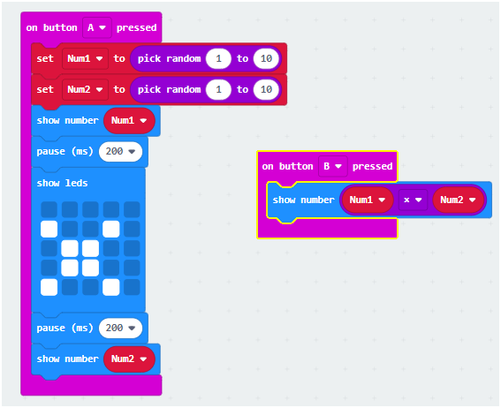
Multiplication Revision Machine
Write a program to
When A is pressed, display a multiplication problem of any two numbers from 1 - 10,
When B is pressed, display the product of those numbers

Slide 24
Multiplication Revision Machine
Stretch Tasks
Make the program use the other math operators (+, -, /)
Notes:
Learners should then start to program their own name badge. This is the first time that learners will have used the micro:bit in the lesson and they are certain to enjoy the task. The most challenging part of the task will be transferring the hex file from the PC onto the micro:bit. This should initially be demonstrated by the Teacher. It is also worth stressing that all of the blocks are colour coded, which should help learners to find where they are located.
How to Ensure that MakeCode is available
Ensure the following website are unfiltered (a constantly updated list is available at https://support.microbit.org/support/solutions/articles/19000030385-firewall-whitelist-requirements-for-micro-bit-editors)
You need access to USB devices if these are blocked by default all Micro:bits use the same ID – use your security policy to exempt the micro:bit ID
PXT / MakeCode/Javascript Blocks Editor:
pxt.microbit.org
makecode.microbit.org
makecode.com www.pxt.io trg-microbit.userpxt.io pxt.azureedge.net
github.com Blocks:
www.microbit.co.uk
Touch Develop:
www.microbit.co.uk
Code Kingdoms:
www.microbit.co.uk
microbit.codekingdoms.com
Python Web Editor (microbit.co.uk)
www.microbit.co.uk
Python Web Editor (microbit.org)
python.microbit.org

Slide 25
Concepts Learnt
In this microbit project we have covered:
Inputs
Basic math
Variables
Testing and troubleshooting
Random numbers
and combined them to make a useful project. This is what Computing is all about, using the tools to make something useful.

Slide 26
Session 3: Rock Paper Scissors Game And Pinwheel Animations
Topic: Randomization and Conditional Decision making
Activity: Multiplayer game using variables and an animation using loops.
Practice: Code the Microbit to display a dance sequence

Slide 27
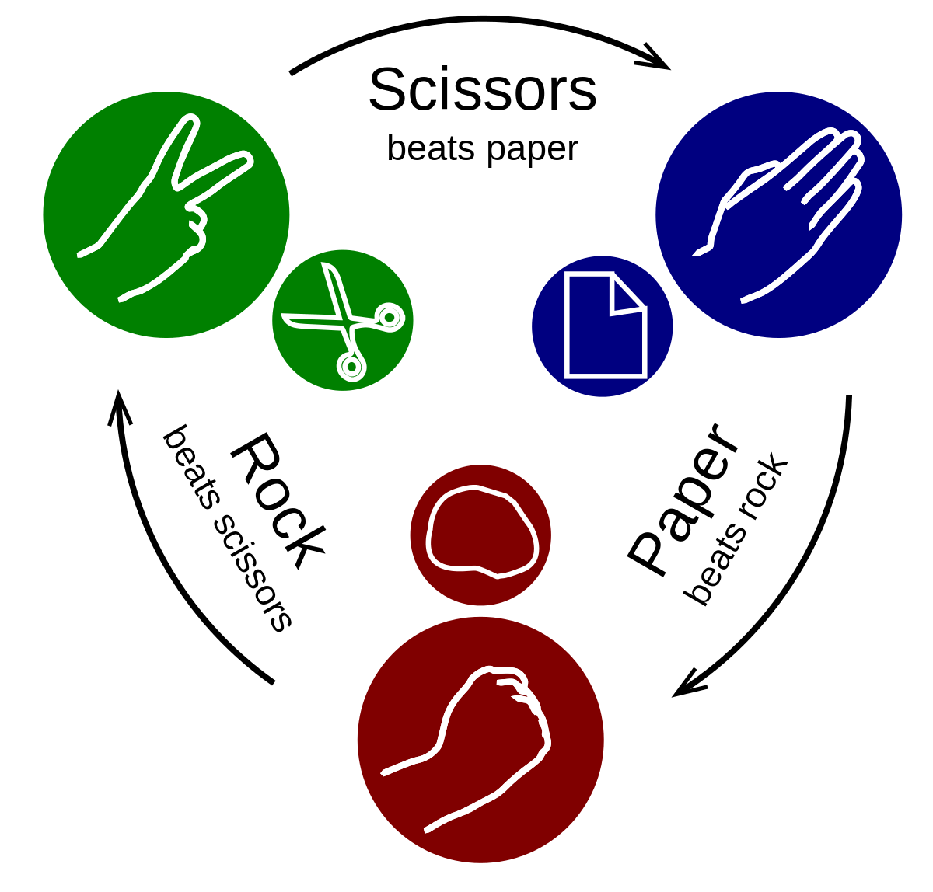
Rock, paper and Scissors
Before starting to develop the game it is useful to play it
With a partner you will shortly play the game
After the counting to three each player will choose whether they are rock, paper or scissors by making the relevant shape with their hand
The winner will be determined using the algorithm below:
Scissors cuts paper so scissors wins
Paper wraps rock so paper wins
Rock blunts scissors so rock wins
If both players choose the same object the game results in a draw

Slide 28
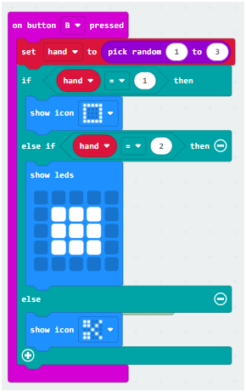
Rock, Paper, Scissors
Code your Microbit to build a Rock Paper Scissors game that you can play with your friends.
On pressing button B, the Rock, paper and scissors icon should be selected randomly.

Slide 29
Introducing animations
We will we program microbit to create animation.
Based on what you already know, how could we do this?

Slide 30
Exploring repetition
Repetition allows us to tell the computer to repeat a set of instructions several times instead of writing the instructions out again.
How could we use repetition to improve our animation?

Slide 31
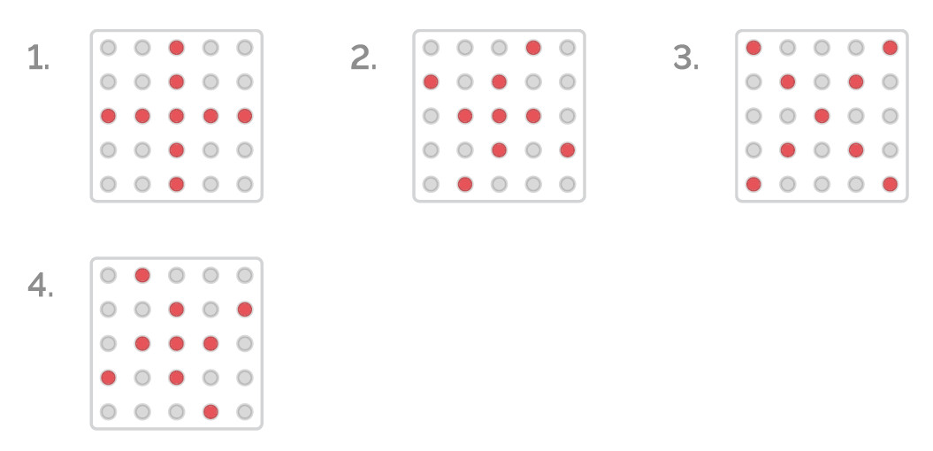
Pinwheel
Create a simple animation of a Spinning pinwheel on the Microbit display.

Slide 32
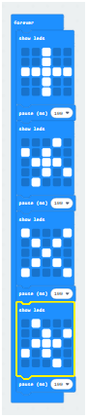
Pinwheel
Create simple animations of a pinwheel using Micro Bit LEDs.

Slide 33
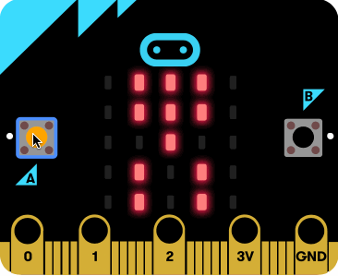
Dance Animations
Stretch Tasks
Create a Dance sequence on the Microbit
Create an image to represent each step of your dance sequence.
Arrange the images in the correct sequence.

Slide 34
Session 4: Random Blinking Dots And Luminating Dots Topic: LED Co-ordinate Grid and nested loops Activity: Plot & toggle LEDs using Co-ordinates Practice: Image on the LED grid using co-ordinates.

Slide 35
LEDs and Co-ordinates
In this session students will learn about microbit LED matrix. They will create programs using coordinates and LEDs.
Learnings
Understand that the 5 x 5 grid of LEDs on the microbit represents a coordinate grid with the origin (0,0) in the top left corner.
Understand that the values of the x coordinates range from 0 through four and increase from left to right.
Understand that the values of the y coordinates range from 0 through four and increase from top to bottom.
Learn how to refer to an individual LED by its X and Y coordinates.
Learn how to plot (turn on) and unplot (turn off) individual LEDs and how to toggle between these two states.

Slide 36
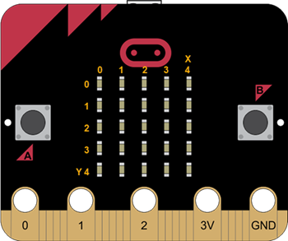
Coordinate grid and LEDs
5 x 5 grid of LEDs on the microbit represents a coordinate grid

Slide 37
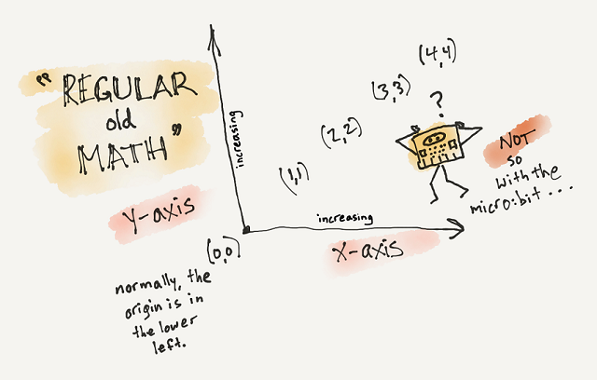
Co-ordinate Grid (Mathematics)
Let’s understand the two major differences between the microbit LED grid and the coordinate grid

Slide 38
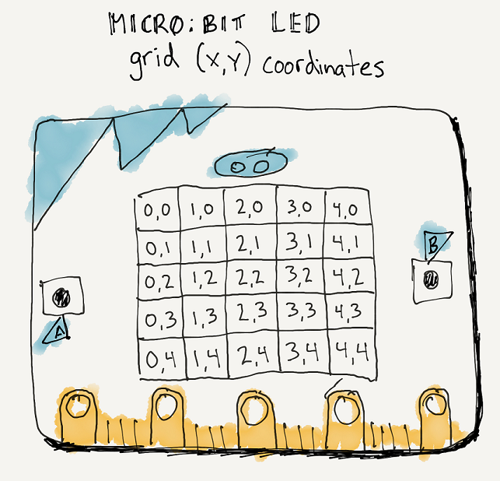
Microbit LED Grid

Slide 39
Microbit LED Grid
The first value in a coordinate pair is the x value and the second value in a coordinate pair is the y value.
A simple way to remember which value comes first is to remember their order in the alphabet. The letter x comes before the letter y in the alphabet and the x coordinate comes before the y coordinate in a coordinate pair.

Slide 40
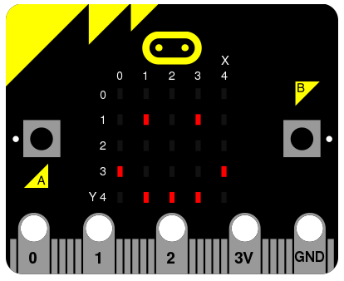
Displaying Images
Use the plot block to display a smiley
Notes:
By turning LEDs on and off you can create images, similar to pixels on a screen that can be built up to create images.

Slide 41
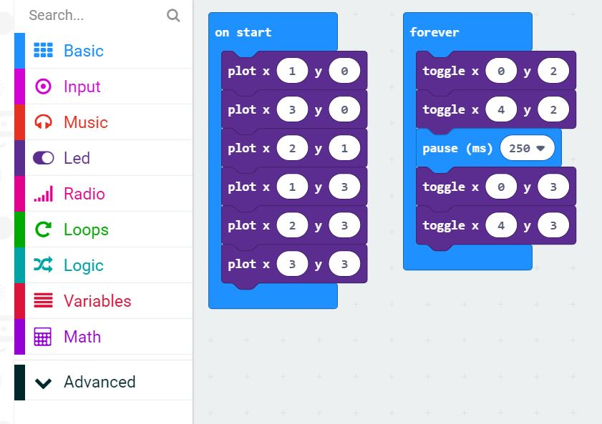
Displaying Images
Project 1: Display a Smiley using the plot Blocks

Slide 42
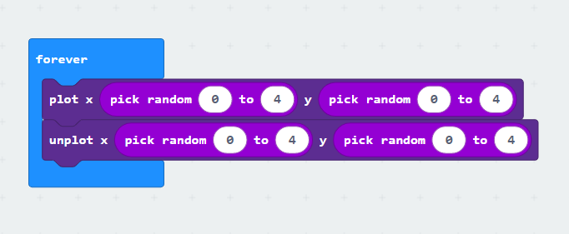
Starry Lights
Create random blinking dots on the LED grid using plot, unplot and random blocks

Slide 43
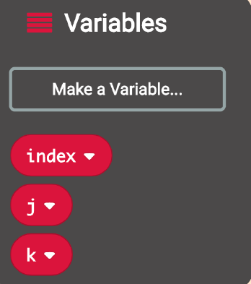
ILLUMINATING DOTS
Create a line of dots with the 0 to 4 loop and a variable block.
First name some new variables to go with the “index” variable

Slide 44
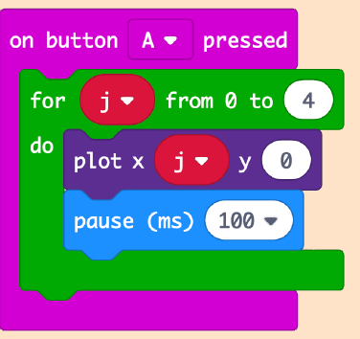
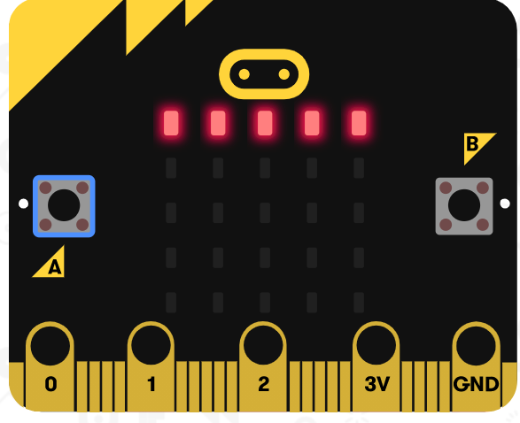
ILLUMINATING DOTS
Use a for loop to “step” the x coordinate through positions 0-4.

Slide 45
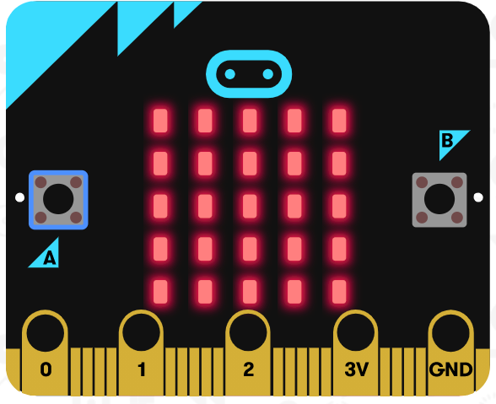
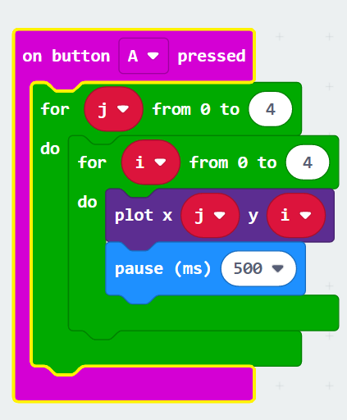
ILLUMINATING DOTS
Edit the program to illuminate second row , third row and then fourth row of LED grid.
Fullgrid Challenge : Edit the program so that the blinking lines cover the whole LED grid
Use unplot and pause blocks to change the animation effect.

Slide 46
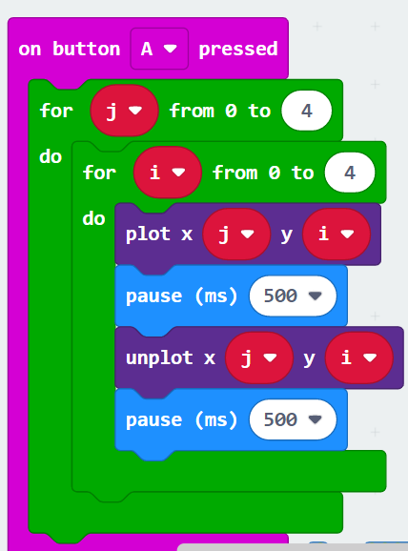
Moving Dot
Create a moving dot that starts from origin and subsequently travels through the entire LED grid.

Slide 47
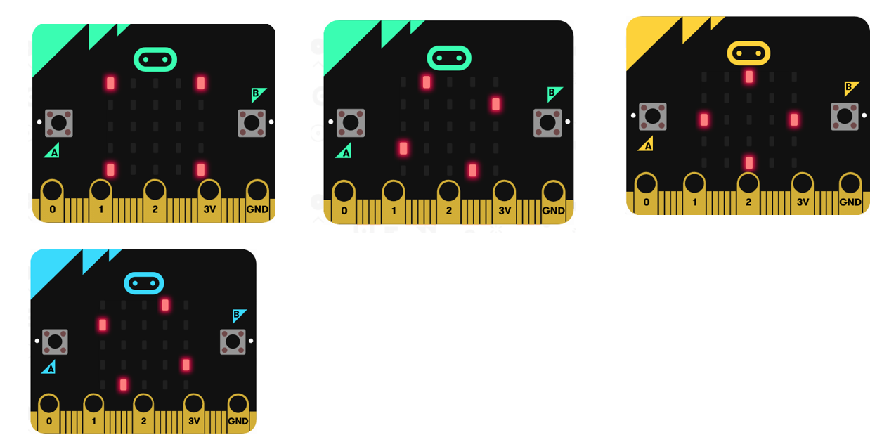
Screensaver

Slide 48
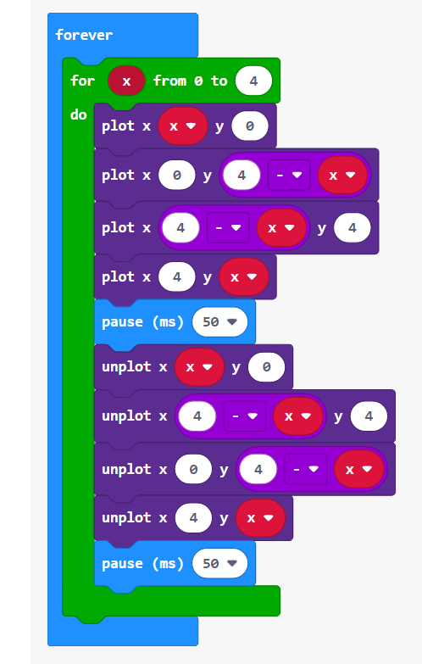
Screensaver
The project uses a for loop with the plot/unplot blocks to create a symmetrical design on the screen.

Slide 49
Session 5: Button Click game Topic: Score keeping and timers using game blocks Activity: Game design Strategy, tracking Score and time Practice: Customize a counter which increments and decrements on button click

Slide 50
Game Design
Let’s make a Button Click Game that counts the number of times you press button B in 10 seconds. The game displays “press A+B to start,” and the game will begin when you press buttons A+B. When the game starts, the timer will be displayed to count down from 10. When the timer is up, “Game Over” will be displayed. Then the score will be displayed at the end.
Break down the Game into smaller parts

Slide 51
Questions to be asked
How many players play the game?
One
What happens when the micro:bit is powered on (before the game starts)?
The game displays “Press A+B to start.”
How does the player start the game?
The player pressed buttons A+B to start the game.
What happens when the game starts?
The timer should be displayed and start counting down.
What actions does the player perform?
The player clicks button B as many as times he/she can.
How does the game respond to the action?
The game counts the number of button B clicks.
How does the game end?
The game is over when the timer is up (countdowns from 10 to 1).
What is the outcome when the game ends?
The score (number of player’s button B clicks) should be displayed when the game ends.
What happens when the game starts again?
The score and the timer need to be reset.

Slide 52
Break down Plan
Let’s start building a Scoring system
Program a Score System for the Button Click Game

Slide 53
Scoring System
Checklist
Create the “score” variable.
Pressing Buttons A+B will start the game, and the beginning score should be set as 0.
When button B is pressed, the score will increase by 1.
When button A is pressed, the score will be displayed

Slide 54
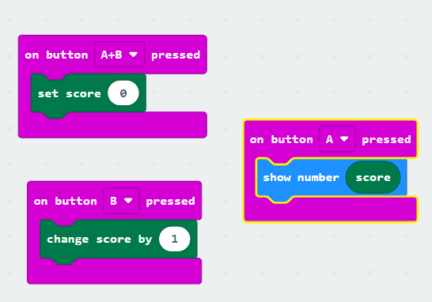
Scoring system
We will add more to this program to complete the Button Click Game

Slide 55
Timer
Checklist
Pressing button A will trigger the “timer is on” state.
“timer” is a variable.
When button A is pressed, the timer will be set to 10.
While the timer is greater than 0,
The number that the timer variable holds will be displayed on the screen.
The program will pause for 1000 ms (1 second).
The variable “timer” will be changed by -1. If the timer was at 10, then it will become 9.
Let’s Code a timer.
Use the timer in the Button Click Game.
Take a variable known as timer.

Slide 56
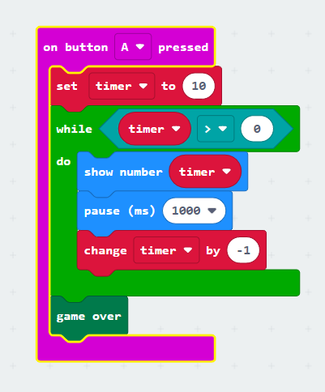
Timer
“Timer” will be changed by -1. If the Timer was at 10, then it will become 9.
The while block is one of the Loop blocks. This block allows you to create a loop that runs while a certain condition is true. In our example, the blocks in the while loop will be repeated as long as the condition, “timer is greater than 0,” is true.
Ask students when a program will be out of the while loop.

Slide 57
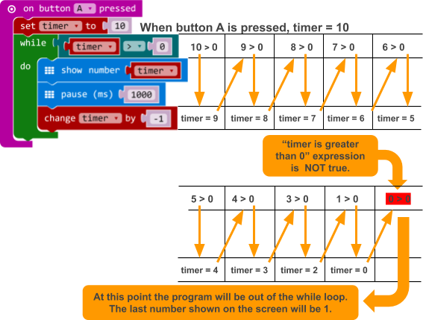
Timer
How this program makes a timer. It is a timer because the program pauses for a second between changes in the variable number timer. For example, a microbit will show the variable timer’s initial value of 10 and then pause for 1 second; the timer value will become 9, and then pause for 1 second until the timer value hits 1. This logic makes this program a timer that counts down 10 seconds.
while the timer value is greater than 0, it’ll be in a “timer is on” state in your program. As soon as the program is no longer in the while loop, which means that the timer is up, it’ll be in the “timer is off” state.
One way to make a timer in the MakeCode there can be different ways to program a timer in the MakeCode.

Slide 58
Let’s Plan the Button Click Game
Variables
Score
Timer
Displays
A message appears on the start screen, such as “press A+B to start.”
The timer value is displayed while the game is running.
The score is displayed when the game is over.
Player’s Inputs
A+B to start the game
B to score a point
Starting state
Switch to game running by pressing A+B.
Game is running
Switch to game over when the timer is 0.
Game over
Switch to game running by pressing A+B.

Slide 59
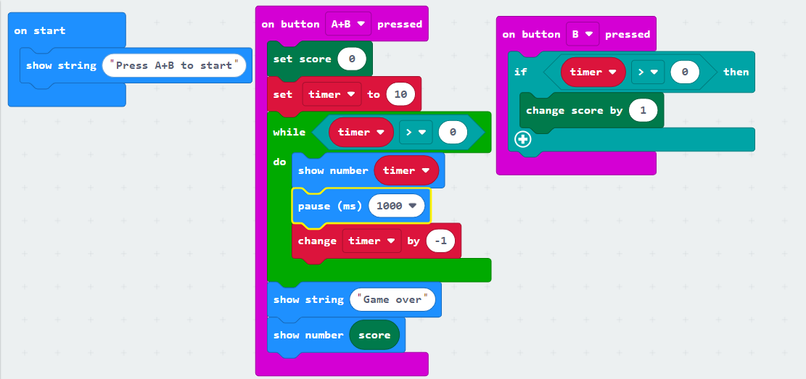
Button Click Game

Slide 60
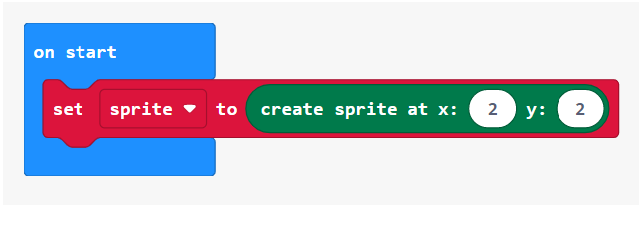
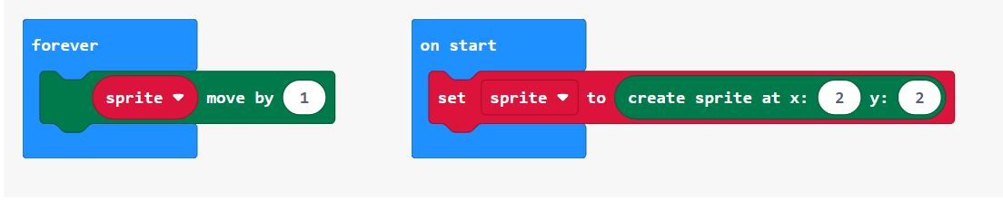
Practice: Snap the Dot
Create a sprite
Snap the dot is a game where the player has to press A exactly when the dot reaches the center of the screen.
Move the dot

Slide 61
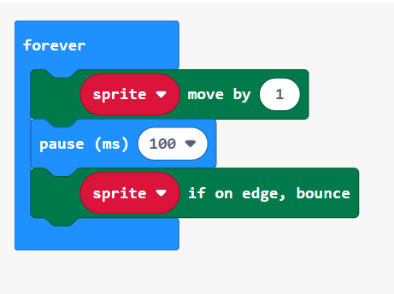
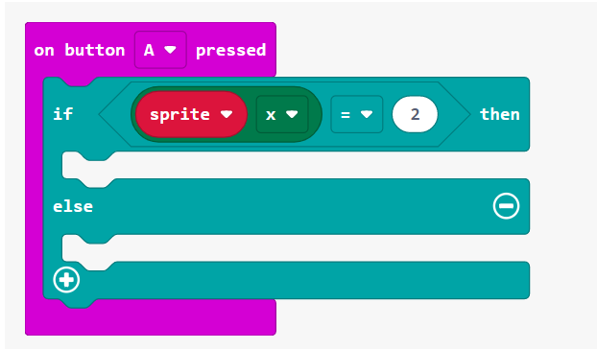
Snap the Dot
Bounce
Button A pressed

Slide 62
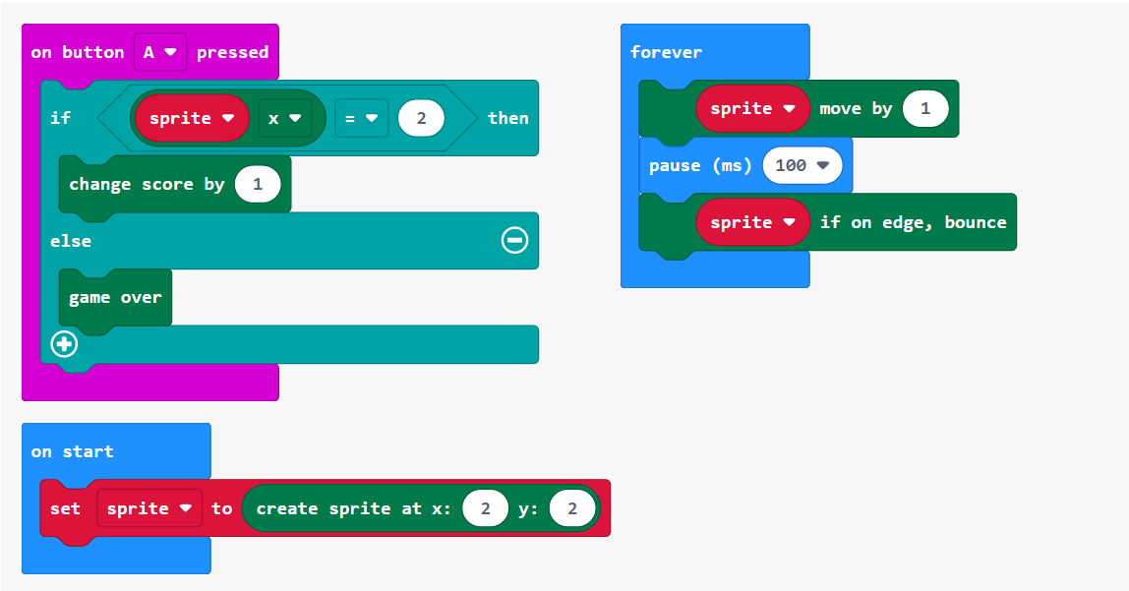
Snap the Dot

Slide 63

Session 6: Experiment With Light
Topic: Sensing light levels and their application
Activities: Display room brightness level in numbers and by plotting graph
Practice: Create a microbit display that lights up automatically when night falls

Slide 64
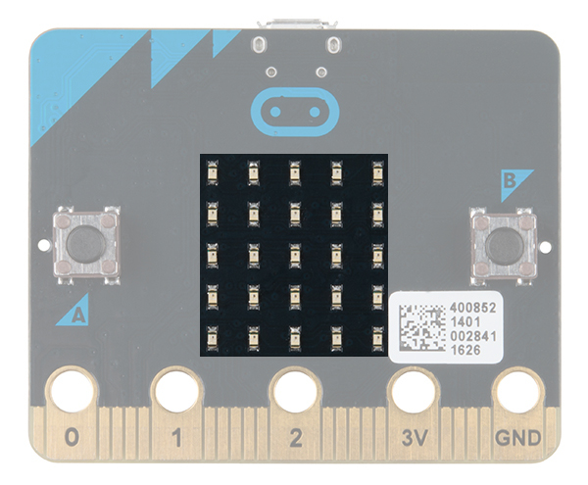
Microbit LED display as light sensor
The LEDs on the microbit can also work as an input device light sensor, measuring the amount of light falling on them.
This means that microbit programs can make different things happen depending on how light or dark it is.

Slide 65
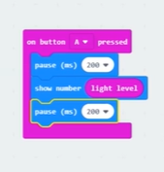
Let's check the Room brightness
LEDs are used as input device to check light level.
LEDs are also used as an output device to display light level.
Simultaneously it's not possible.
Therefore, we will add pause and clear screen

Slide 66
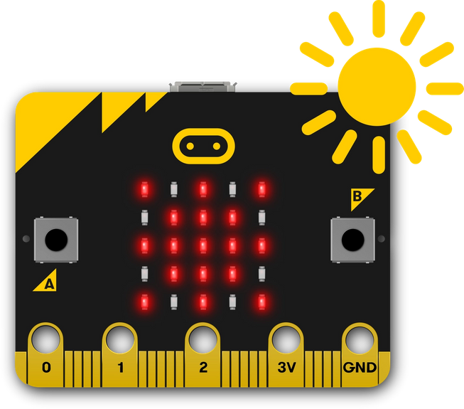
Sunlight Sensor - Turn the LED display into a sensor to make your micro:bit react to light.
The program uses an ‘if… else’ statement to show the sun image only if the light level is greater than (>) a certain level.
Flash this program onto the microbit and shine a light source, like a torch, daylight or bright ceiling light on to the microbit, and you should see the sun appear.
Cover the microbit with your hand and the sun icon should vanish.
If it doesn’t work, try making the 100 number smaller to suit the lighting where you are.

Slide 67
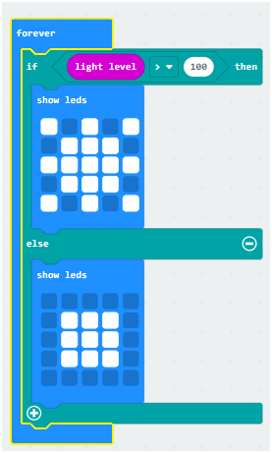
Sunlight Sensor

Slide 68

Light level Reader
create a light level meter which uses the light sensor on the micro:bit to detect the amount of light.
Create a variable, reading, to set to the current light level inside the forever loop.
Plot a bargraph of the reading of the light level
Go to the simulator and watch the bar graph change while you adjust the light level control.
Add the code to show a number for the reading value if the button A is pressed.

Slide 69

Small Rear Light for Bike
A simple rear light for a bike which automatically turns on more LEDs as it gets darker. If the level is less than 50 then all the LEDs are turned on. The value is between 50 and 100 then the just the centre 9 LEDs are lit, and last case all LEDs are off.

Slide 70
Session 7: Fortune Teller And Bubble Level Tool
Topic: Motion sensing using Accelerometer
Activity: Motion and gesture detection using accelerometer sensor.
Practice: Bike indicators

Slide 71

Accelerometer
An Accelerometer is a motion sensor that measures movement.
The micro:bit has a built in accelerometer, which is used for detecting specific motions and the speed of the micro:bit.
The Accelerometer in BBC micro:bit detects when someone shakes it, tilt the device left to right, backwards and forwards or up and down.
There are two different versions of the micro:bit board. Newer micro:bits have a combined compass and accelerometer chip and on the older ones they are separate. Both versions work in exactly the same way.
Notes:
There are endless ways you can use this feature in your programs such as creating a pedometer that measures each step taken or measuring the acceleration of an object by attaching the micro:bit and sliding it down a ramp, or even just measuring movement like a shake of the micro:bit to simulate the roll a die like this example. Each time you shake the micro:bit the accelerometer detects the movement and displays a random number from 1-6.

Slide 72
Three Axes – x, y and z
Think about an Aeroplane – it can move:
Up and down
Forward and back
Left and right
If we pair these up we get three axes – x, y and z
Acceleration can occur along each of the three axes x, y and z
y
Up
Back
x
left
Right
Fwd
Down
z

Slide 73

x-axis
This refers to the acceleration to the right or left
Hold the micro:bit and tilt it to the right or left and it will respond

Slide 74
y-axis
This refers to the acceleration to the upward and down
Hold the micro:bit and tilt it downward or toward yourself

Slide 75
z-axis
This refers to the acceleration from moving the micro:bit up or down
Hold the micro:bit flat and lift it up or down

Slide 76




Acceleration in x-axis
Tilting the Micro:bit to the left increases the motion sensor. This time, the readings are in the negative range from 0 to -1023.
Tilting the Micro:bit to the right increases the motion to the sensor. The measurements go up to a maximum of 1023..

Slide 77
Acceleration in x-axis
Tilting the Micro:bit to the left increases the motion sensor. This time, the readings are in the negative range from 0 to -1023.
Tilting the Micro:bit to the right increases the motion to the sensor. The measurements go up to a maximum of 1023..

Slide 78


Fortune teller Game
It is fun with fortune tellers right! But they cost a lot and can be difficult to use.
Let’s make our own fortune teller.
You can ask it any yes, no or maybe question and it will give you the answer. This can be fun for kids of any age or as a family activity.

Slide 79
Spirit Level
In this project, we are going to turn our BBC micro:bit into a digital spirit level, a tool designed to indicate whether a surface is horizontally flat. A spirit level is an instrument used by carpenters, stonemasons, bricklayers, and other building trades workers.
we’ll use the microbit reading to display information on the micro:bit’s screen to indicate whether or not the surface is flat.
Traditionally, spirit levels have a glass vial filled with a coloured liquid, leaving a bubble in the tube. When that bubble is central within the glass vial, it indicates that the spirit level is resting on a perfectly flat surface.

Slide 80

Spirit Level
https://codecreated.com/2017/12/20/bbc-microbit-spirit-level-app-sample/

Slide 81
Session 8:Bluetooth
Topic: Microbit connectivity with phone using Bluetooth
Activity:Spread Smiles- Let’s spread the smiles by making a smiley or a heart appear magically on the Microbit through a smartphone using the Bluetooth application.
Practice:Send messages through Bluetooth- Code the microbit to receive messages from the smartphone through Bluetooth.

Slide 82
Bluetooth
Bluetooth is a protocol for wireless communication over short distances. It was developed in the 1990s, to reduce the number of cables. Devices such as mobile phones, laptops, PCs, printers, digital cameras and video game consoles can connect to each other, and exchange information. This is done using radio waves. It can be done securely. Bluetooth is usually only used for relatively short distances, like a few metres. Some signals can be up to 100 metres.
Bluetooth name was taken from Danish King Harold Bluetooth.
Frequency range is unlicensed in many countries, which allows open source development of bluetooth.

Slide 83


Slide 84
Session 9:Let's play with Sound
Topic:Students will use the Microbit’s inbuilt speaker and microphone to make interesting applications. They will learn to code the microbit to work when you clap your hands or snap your fingers.
Activity:1. Clap lights- Turn your microbit into a light that you can turn on and off by clapping or making any loud sound.
2. Sound Meter: Measure how noisy it is around you using the new microbit's microphone sensor and a simple bar chart display.​
Practice:Alarm Clock: Code the microbit to work as a musical alarm clock.

Slide 85

Sound Meter
Measure how noisy it is around you using the new micro:bit's microphone sensor and a simple bar chart display.
The new micro:bit's microphone measures sound levels in numbers between 0 and 255. 0 is the quietest and 255 is the loudest sound measurement it can make.
The code uses a forever loop to keep the microphone measuring sound levels and plotting a bar graph on the LED display.
The louder the sounds measured, the higher the bar graph gets.
Learnings
How to use the new micro:bit's built-in microphone input sensor to measure how loud sounds are around you
How to display numerical data from input sensors graphically on the LED display output

Slide 86
Clap Lights
Turn your micro:bit into a light that you can turn on and off by clapping or making any loud sound.
How it works
When the microphone sensor detects a loud sound, the code toggles the value of lightsOn by setting it to be not lightsOn.
This means that when you clap, if lightsOn is false (and the lights are off), it becomes true and the program lights the LEDs.
If lightsOn was true (and the lights were on), it becomes false and the code switches the LEDs off by clearing the screen.
Learnings
How to switch outputs in response to sensor inputs
How to use Boolean logic to make a switch that toggles on and off when triggered by the same event

Slide 87

Clap Lights

Slide 88
Session 10: Metal Detector And Magnetic Compass
Topic: Magnetic force and calibration
Activity: Turn micro bit into a compass to display directions and use it as a metal detector by measuring the magnetic force around the device.
Practice: Magnetic door alarm make a magnetic alarm that rings whenever someone opens the door

Slide 89

Making a Compass
A compass can be used to determine which direction you are pointing in
This can be useful when navigating
A compass can be used when reading a map to help you to ensure that you are heading in the correct direction
You can use your micro:bit as a compass

Slide 90

The Compass
A compass is an instrument which shows the direction of magnetic north
This direction is measured in degrees and is called a bearing – from this your location can be calculated.
A compass has four cardinal points: north, east, south and west
The magnetised metal indicator in a compass is free to move and always points towards magnetic north
Notes:
Explain how a Compass works

Slide 91
Compass Calibration
A digital magnetic compass is an indispensable part of any ship or vessel sailing in the sea.
A digital magnetic compass consists of a magnetometer which relies on earth’s magnetic field to indicate the direction.
The output of the magnetic compass is susceptible to change if any stray magnetic field or ferrous materials are present in the vicinity.
An output of any magnetometer will be a combination of earth’s magnetic field and any other magnetic fields present around.
Before a digital magnetic compass is put to the actual use, it is very important to calibrate it so as to compensate for the factors which affect its output from the correct value.

Slide 92
Compass Calibration
Calibration Of a Digital Magnetic Compass And Swinging Of The Ship
What could be the correct procedure for calibrating a compass being used on a vessel?
The process, called the swinging of the ship involves the ship making a 360 Deg. round in the water with compass installed on board.
The digital magnetic compass can be calibrated automatically.
Automatic Calibration Of The Digital Magnetic compass
This involves taking a 360 Deg. round in the water with the compass fixed on the ship. When the round is completed, if the compass is calibrated correctly, it notifies the user about the successful completion of calibration.

Slide 93

Activity 1 : Calibrating the Compass
Before you can use the magnetometer as a compass you have to calibrate it.
Use the program below to calibrate
Download the code to your micro:bit to calibrate the compass.
Notes:
Get Learners to try the calibration program or demonstrate it to them.

Slide 94
Activity 1 : Calibrating the Compass
Calibration consists of a little game to draw a circle on the LED display by rotating the device.
The calibration will ask you to draw a circle or fill the LED screen by tilting the micro:bit.
The compass calibration is stored in memory by the micro:bit, so next time you press the reset button or remove and replace the power the calibration will be remembered.
When you flash a new program to your micro:bit via USB, this memory is cleared so you will have to re-calibrate it.
If you are calibrating or using the compass near metal, it might confuse the micro:bit.
Notes:
Get Learners to try the calibration program or demonstrate it to them.

Slide 95

Compass Heading
The Microbit measures the compass heading from 0 to 359 degrees with its magnetometer chip. Different numbers mean north, east, south, and west.

Slide 96
Micro:bit Sensors
The micro:bit has a number of built-in sensors
One of the sensors can tell you which direction you are pointing in – your heading.
This sensor will read the result of the direction you are pointing in as degrees
You can then write a program which will display whether the direction is North, East, South or West
If the number of degrees is measured as being less then 45 or more than 315 then you will be pointing North
Can you think what type of code structure could be used to program this?

Slide 97

Creating a Compass

Slide 98
Creating a Compass
Can you add further options to cover additional directions? Try to develop your code to also include: North East, South East, South West and North West.

Slide 99
Activity 2 : Creating a Compass
Use the following rules :
If the compass heading is less than 45 degrees or more than 315 degrees then you are pointing North
If the compass heading is less than 135 degrees then you are pointing East
If the compass heading is less than 225 degrees then you are point South
Else you are pointing West

Slide 100

Creating a Compass

Slide 101

Let’s see the directions

Slide 102

How Accurate is the compass compared to your phone

Slide 103



Magnetic Compass

Slide 104


Magnetic Force
Find the amount of magnetic force (the strength of a magnet) in the direction you say.
The micro:bit measures magnetic force with microteslas.

Slide 105

Metal Detector
This program plots LEDs according to the strength of magnetic force of the microbit.
Use sound to make metal detector more realistic

Slide 106

Metal detector

Slide 107

Activity 4:
Create a magnetic door alarm which will sound when a change in strength of magnetic field is detected.

Slide 108

Magnetic Door Alarm

Slide 109

Magnetic Door Alarm
We can also make the alarm audible

Slide 110
Magnetic Door Alarm
Add a speaker and an audible alarm
Use a variable to count the number of times your door has been opened - you'll need to add code to sense when it's been opened and closed
Create a timer to measure how long a door has been left open.

Slide 111
Session 11: Smart Temperature Sensor
Topic: Sensing Temperature of our surrounding
Activity: Current temperature display, Record the lowest and the highest temperature.
Practice: Convert Celsius to Fahrenheit temperature

Slide 112

Temperature Sensors
The micro:bit also has the capability to detect temperature while it does not have its own temperature sensor.
The microprocessor chip, which can be found on the back of the board is micro:bit’s brain - fetching, decoding and carrying out the instructions.
It also contains a temperature sensor that can detect changes in temperature in the environment.
This means that while the temperature is not necessarily accurate at determining the actual temperature and may be off by a few degrees, it is precise and great at measuring the change in temperature.
Notes:
There are endless ways you can use this feature in your programs such as creating a pedometer that measures each step taken or measuring the acceleration of an object by attaching the micro:bit and sliding it down a ramp, or even just measuring movement like a shake of the micro:bit to simulate the roll a die like this example. Each time you shake the micro:bit the accelerometer detects the movement and displays a random number from 1-6.

Slide 113
Sensors
Sensors allow a computer to detect certain measurements
The measurements from a sensor will be processed and the micro:bit program can make decisions based on the value
Sensors can be analogue or digital
Digital sensors can only detect a single status, for example if a temperature is above 50ºC or not – they display the result as either a 1 or a 0
Analogue sensors continually measure values within a range
Notes:
Use examples to show difference between Analogue and digital sensors. Digital sensors are like switches – either on or off – eg door sensors in an alarm system. Analogue sensors measure continuously like a speed or temperature sensor. The program may make a digital system based on analogue data – it changes what it does if an analogue value is larger than a given value.

Slide 114
Types of Sensor
Different sensors can detect different things
You are going to develop a temperature sensor on a micro:bit
In addition to temperature sensors there are a range of different sensors which can detect different things
Notes:
Perhaps use the m

Slide 115

Temperature Sensor
A temperature sensor can be used to measure how hot or cold an object is
Temperature sensors have two different types of metal which conduct an electrical charge between them
As the temperature increases so does the electrical charge between the two metals
This voltage is measured and converted into the temperature in degrees
This Photo by Unknown Author is licensed under CC BY-SA

Slide 116


Make a Thermometer - Shows how hot or cold the micro:bit is using the built-in temperature sensor.
This program shows how hot or cold the micro:bit is by taking a reading from the temperature sensor in its processor or CPU (central processing unit).
The processor’s temperature is a fairly good approximation of the temperature around in °C (Celsius).
In this program, when input button A is pressed, the micro:bit displays the processor’s current temperature on its LED display output.
-> Take the micro:bit into warmer and colder places and see how the temperature readings change.

Slide 117
Smart Thermometer
Record the lowest temperature and highest reached temperature while the Microbit is awake.
variables:
currentTemp is the current temperature reading,
max is the maximum and min is the minimum.
At the start of the program they are all set to the same value; an infinite (forever) loop ensures that every two seconds it takes a reading, and the program compares the current temperature with the max and min variables.

Slide 118

Smart Thermometer
Record the lowest temperature and highest reached temperature while the Microbit is awake.

Slide 119
Functions
A function lets you create a portion of code that you can reuse in your program. This is handy because you can put code that you want to use over again in a function. Instead of copying the same code to many places in your program, you can just use a function you made and all the code inside is used as a single block.
Parameters
If you want to give data to your function, you can include one or more parameters which are values you send to the function. Parameters work like variables inside the function.

Slide 120

Temperature C to F convertor
Write a program so that :
When button A is pressed the temperature output is in Celsius
When button B is pressed the temperature is output in Fahrenheit.
Fahrenheit = ((Celsius x 9) / 5) + 32

Slide 121
Session 12: Step Counter Project Presentation
Topic: Real time application of Microbit accelerometer and Bluetooth phone connection.
Activity: Step counter project completion and presentation

Slide 122

Counting Steps
We need a variable to
record the number of steps
We then increase the steps
each time we shake the
micro:bit
We can display an image to
show we took a step

Slide 123

Displaying Steps
When button A is pressed,
we show the number of steps
for a short amount of time,
then clear the screen

Slide 124

Desirable Features
Desirable:
Show number of steps to target
Set target number of steps
Display motivational messages
Could you record whether a step is taken more accurately?

Slide 125
THANKS!

